Slide 2


Slide 3
This talk is not about UNITY

Slide 4
deciding on an engine
Unity 3d
Phaser.js
construct 2
game maker studio
rpg maker
Duality
Notes:
Things to consider: 2d or 3d, desktop/web/mobile, writing code or visual programming (great for kids), which IDE is used.

Slide 5
deciding on an engine
Unity 3d
Phaser.js
construct 2
game maker studio – humblebundle.com
rpg maker
Duality
Notes:
Things to consider: 2d or 3d, desktop/web/mobile, writing code or visual programming (great for kids), which IDE is used.

Slide 6

It’s about
open source
written in c#
wraps opengl
Developed since 2011
write and debug inside visual studio
Notes:
From the website, “Duality is a modular 2D game engine that provides its own visual editor. It's highly extensible, written entirely in C# and backed by OpenGL.”

Slide 7
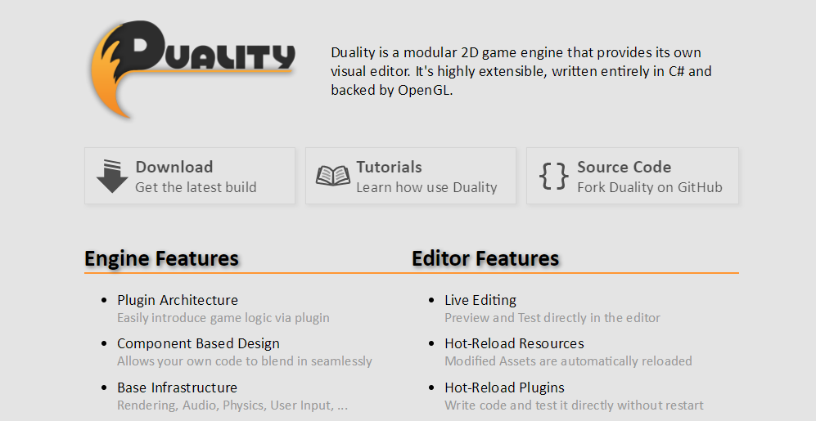
Duality.adamslair.net

Slide 8
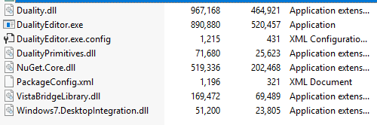
Duality.zip

Slide 14
ICmpUpdatable
OnUpdate() – called every frame

Slide 15
ICmpInitializable
OnInit() – Initialization / object creation
OnShutdown() - Cleanup

Slide 16
ICmpCollisionListener
OnCollisionBegin() – Called the first frame that a collision occurs.
OnCollisionEnd() – Called the first frame after a collision is no longer occurring.
OnCollisionSolve () – Called every frame during the collision when the physics system is solving the physics simulation. Not called for “IsSensor” bodies.

Slide 17

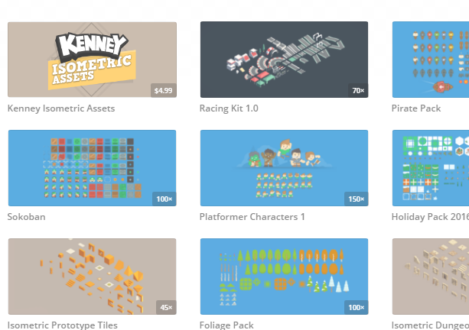
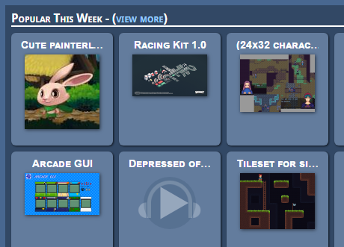
Assets
OpenGameArt.ORG
KENNEY.NL

Slide 18
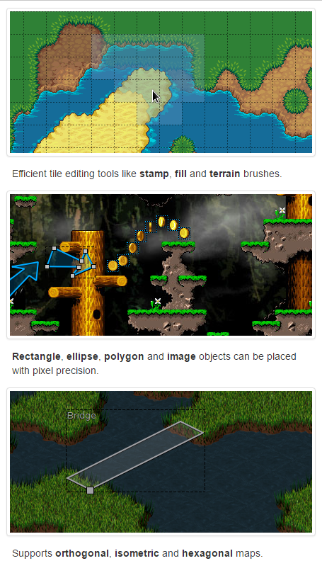
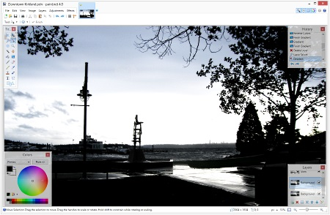
Visuals
paint.net
Tiled

Slide 19
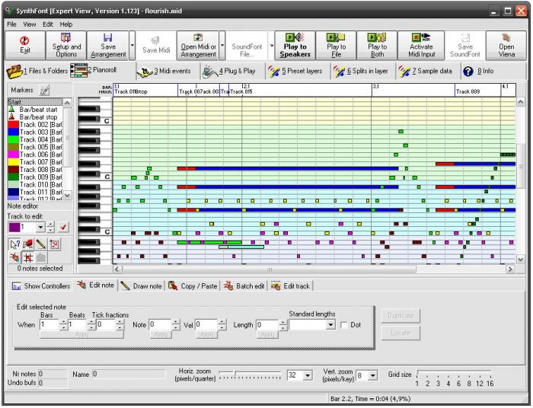
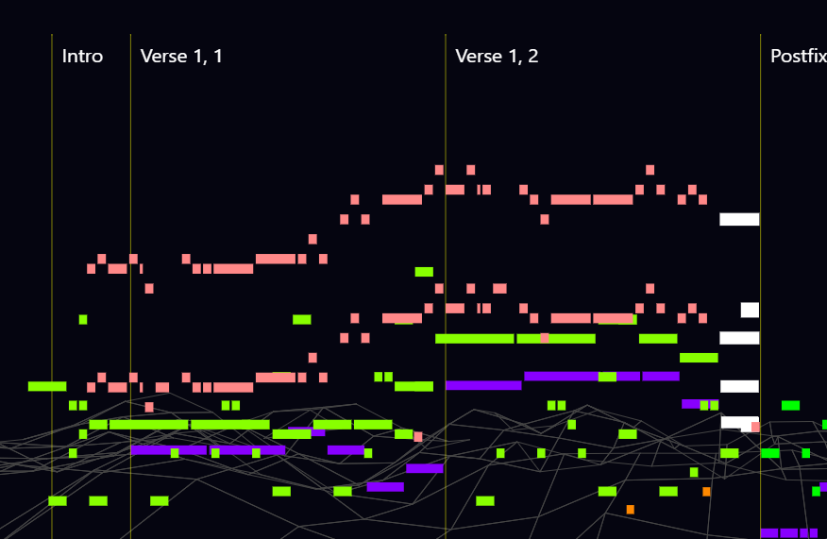
MUSIC
Tiled
Abundant Music
SynthFont

Slide 20
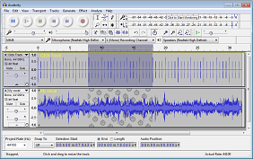
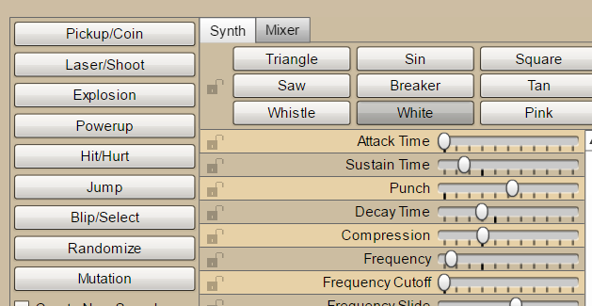
Sound Effects
BFXR.net
Audacity

